Slide 1
Ecosystem
VMware , Xen , KVM

Slide 2
Venders and Projects
Virtual machine venders :
VMware
The company was founded in 1998 and is based in Palo Alto, California. The company is majority owned by EMC Corporation.
Implement both type-1 and type-2 VM.
Xen
First developed in University of Cambridge Computer Laboratory.
As of 2010 the Xen community develops and maintains Xen as free software, licensed under the GNU General Public License (GPLv2).
Implement para-virtualization.
Virtual machine project :
KVM ( Kernel-based Virtual Machine )
A Linux kernel virtualization infrastructure.
As of 2010, KVM supports native virtualization using Intel VT-x or AMD-V.

Slide 3
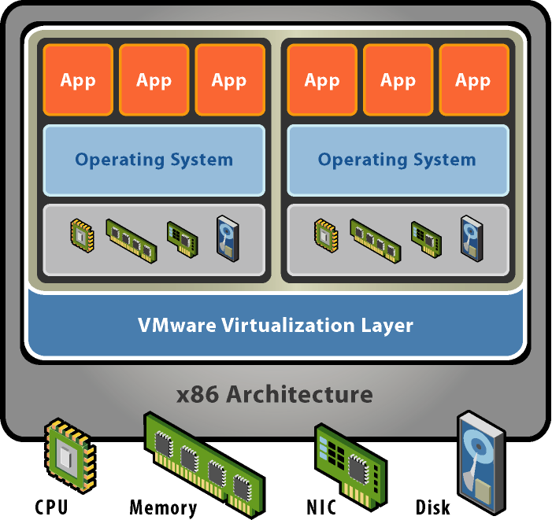
VMware
Basic properties :
Separate OS and hardware – break hardware dependencies
OS and Application as single unit by encapsulation
Strong fault and security isolation
Standard, HW independent environments can be provisioned anywhere
Flexibility to chose the right OS for the right application

Slide 4
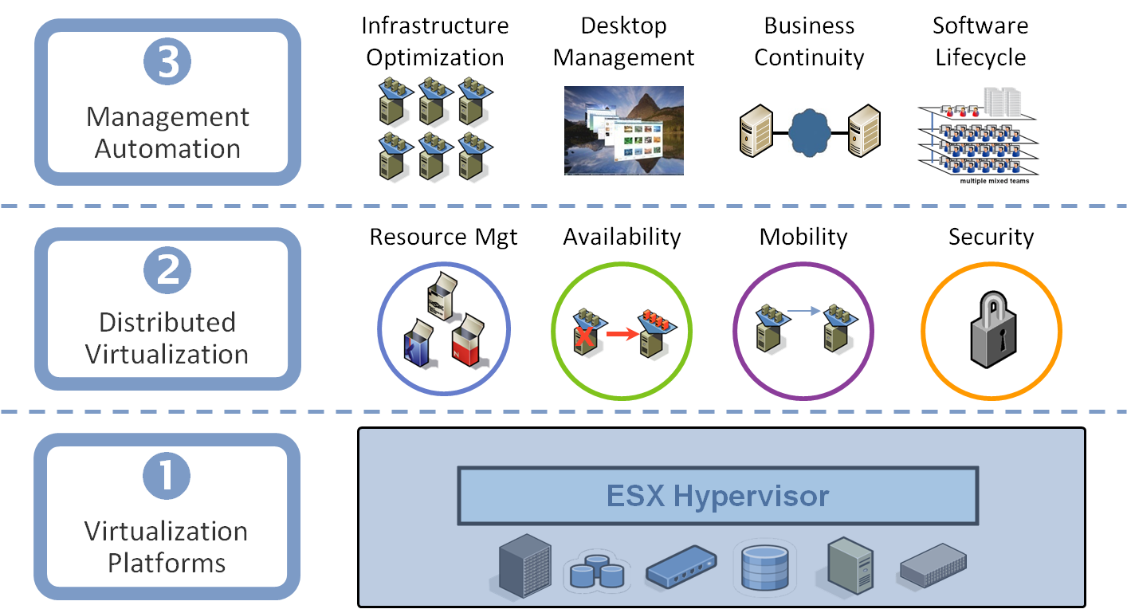
VMware Virtualization Stack

Slide 5
VMware Major Products
VMware GSX Server
Run multiple servers on your server
Hosted Architecture
Available for Linux hosts and Windows hosts
VMware ESX Server
Quality of Service
High-performance I/O
Host-less Architecture ( bare-metal )

Slide 6
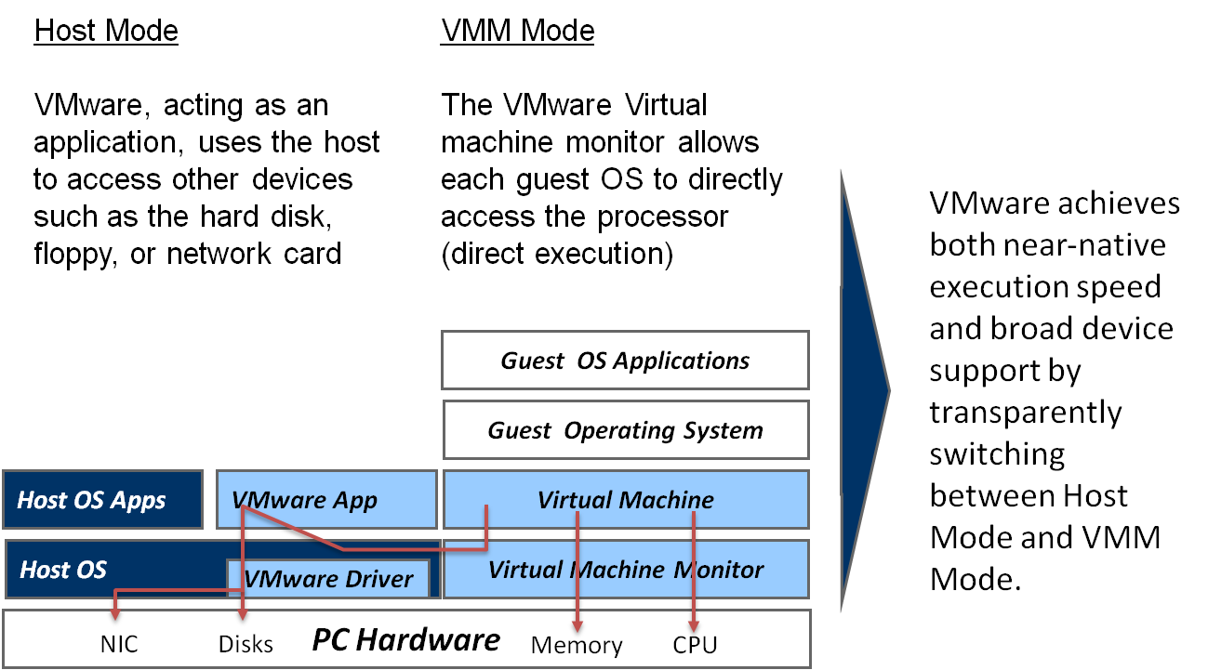
VMware GSX Server Architecture

Slide 7
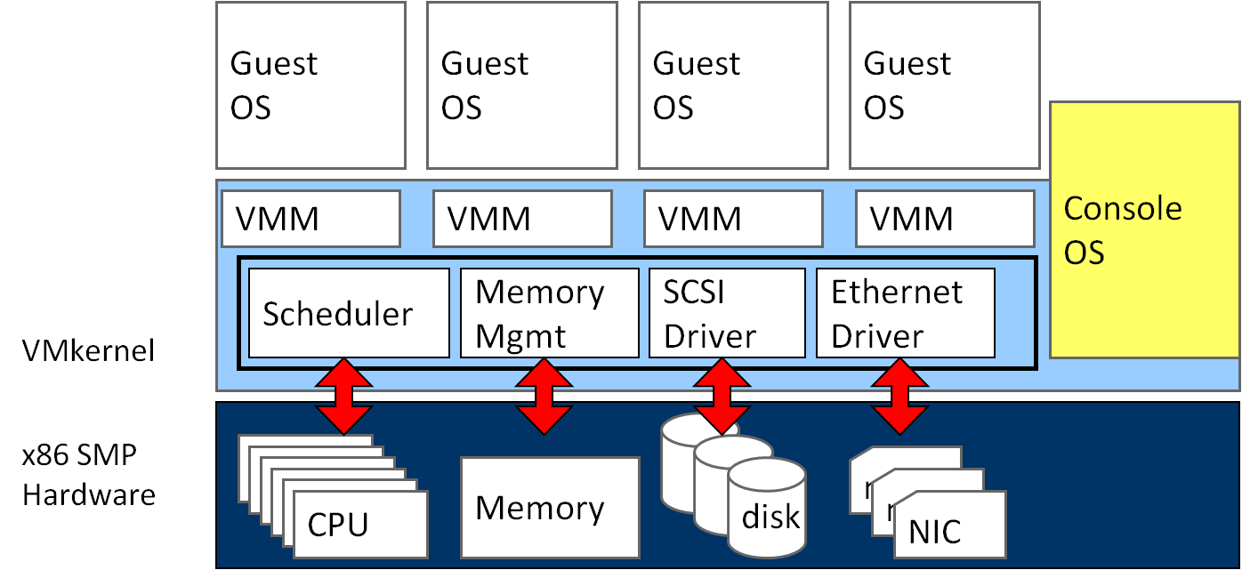
VMware ESX Server Architecture

Slide 8
Xen
Basic properties :
Para-virtualization
Achieve high performance even on its host architecture (x86) which has a reputation for non-cooperation with traditional virtualization techniques.
Hardware assisted virtualization
Both Intel and AMD have contributed modifications to Xen to support their respective Intel VT-x and AMD-V architecture extensions.
Live migration
The LAN iteratively copies the memory of the virtual machine to the destination without stopping its execution.
Implement system:
Novell's SUSE Linux Enterprise 10
Red Hat's RHEL 5
Sun Microsystems' Solaris

Slide 9
Para-virtualization in Xen
Xen extensions to x86 arch
Like x86, but Xen invoked for privileged instructions
Avoids binary rewriting
Minimize number of privilege transitions into Xen
Modifications relatively simple and self-contained
Modify kernel to understand virtualized environment
Wall-clock time vs. virtual processor time
Desire both types of alarm timer
Expose real resource availability
Enables OS to optimize its own behaviour

Slide 10
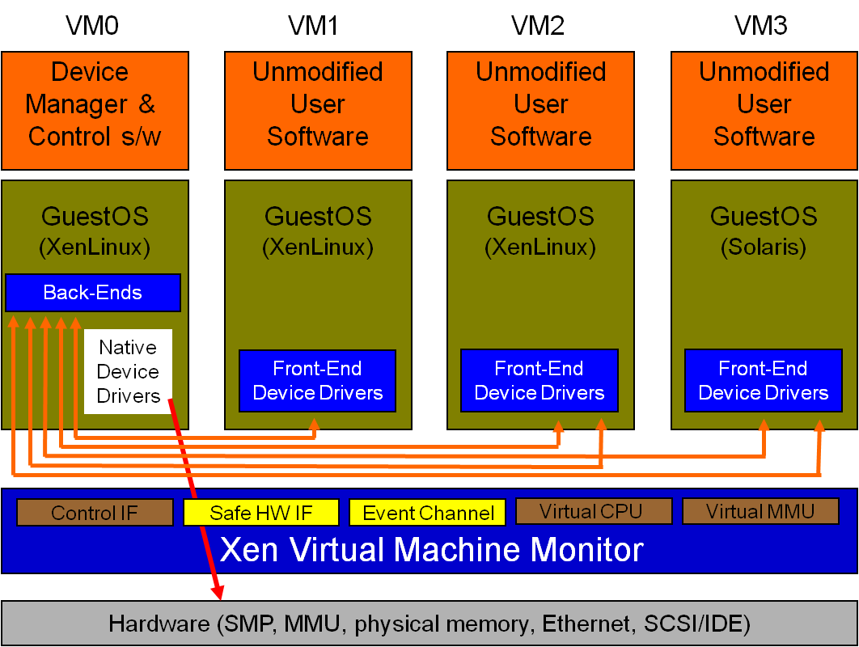
Original Xen Architecture

Slide 11
Hardware Assistance in Xen
Hardware assistance :
CPU provides VMExit for certain privileged instructions
Extend page tables used to virtualize memory
Xen features :
Enable Guest OS to be run without modification
For example, legacy Linux and Windows
Provide simple platform emulation
BIOS, apic, iopaic, rtc, Net (pcnet32), IDE emulation
Install para-virtualized drivers after booting for high-performance IO
Possibility for CPU and memory para-virtualization
Non-invasive hypervisor hints from OS

Slide 12
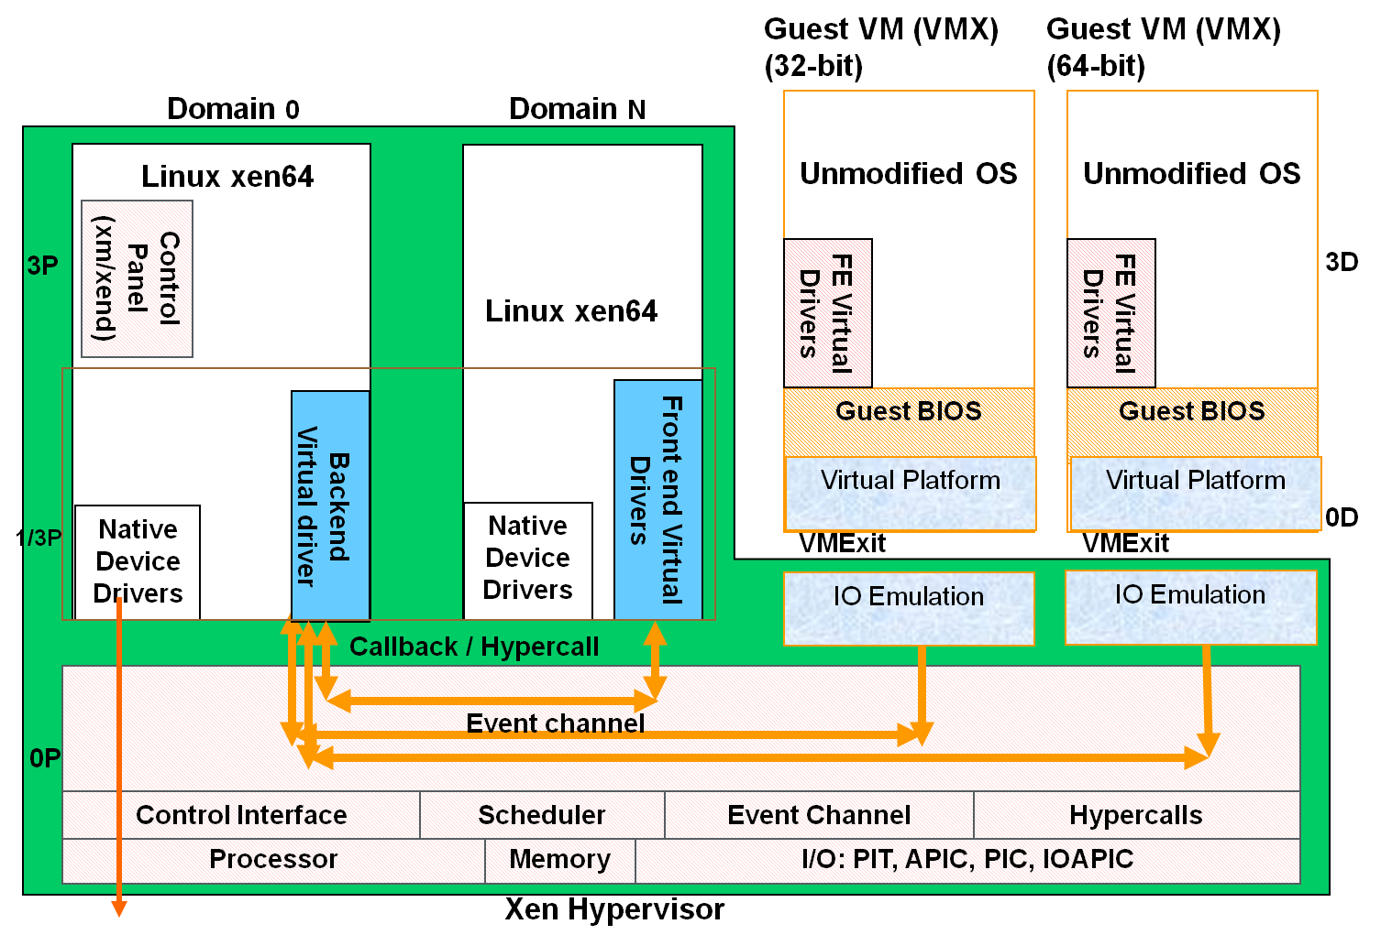
New Xen Architecture

Slide 13
KVM
KVM ( Kernel-based Virtual Machine)
Linux host OS
The kernel component of KVM is included in mainline Linux, as of 2.6.20.
Full-virtualization
KVM is a full virtualization solution for Linux on x86 hardware containing virtualization extensions (Intel VT or AMD-V).
Using KVM, one can run multiple virtual machines running unmodified Linux or Windows images.
IO device model in KVM :
KVM requires a modified QEMU for IO virtualization framework.
Improve IO performance by virtio para-virtualization framework.

Slide 14
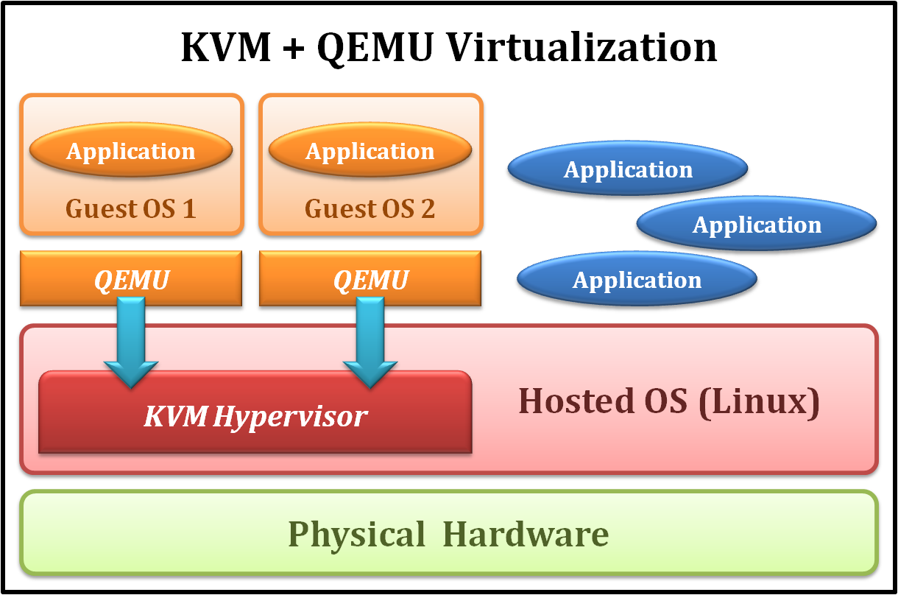
KVM Full Virtualization
It consists of a loadable kernel module
kvm.ko
provides the core virtualization infrastructure
kvm-intel.ko / kvm-amd.ko
processor specific modules

Slide 15
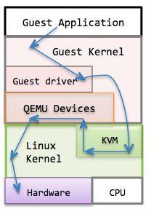
IO Device Model in KVM
Original approach with full-virtualization
Guest hardware accesses are intercepted by KVM
QEMU emulates hardware behavior of common devices
RTL 8139
PIIX4 IDE
Cirrus Logic VGA

Slide 16
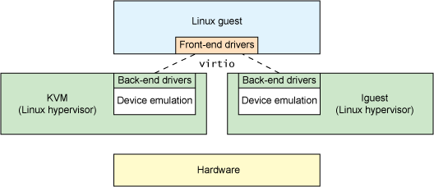
IO Device Model in KVM
New approach with para-virtualization

Slide 17
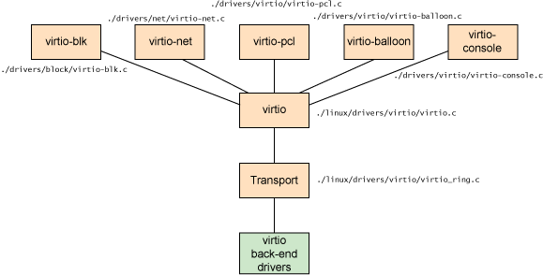
IO Device Model in KVM
virtio architecture

Slide 18
Other Issues
Live migration
Cloud properties

Slide 19
Other Issues
Essential technique of cloud properties implementation
Live migration of virtual machines
Migrate a virtual machine from one physical machine to another in the run time with a small amount of performance down grade.
Virtualization enabled cloud properties :
Scalability
Virtual machine system automatic scale up
Availability
Fault tolerant of hardware and software
Manageability
Automatic physical to virtual system transformation
Performance
Dynamically virtual machine level load balancing

Slide 20
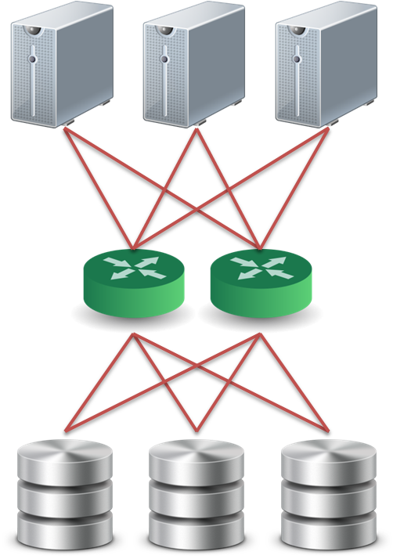
Live Migration Technique
Pre-assumption :
We assume that all storage resources are separated from computing resources.
Storage devices of VMs are attached from network :
NAS: NFS, CIFS
SAN: Fibre Channel
iSCSI, network block device
drdb network RAID
Require high quality network connection
Common L2 network (LAN)
L3 re-routing
VM 1
VM 2
VM 2
Disk
VM 1
Disk

Slide 21
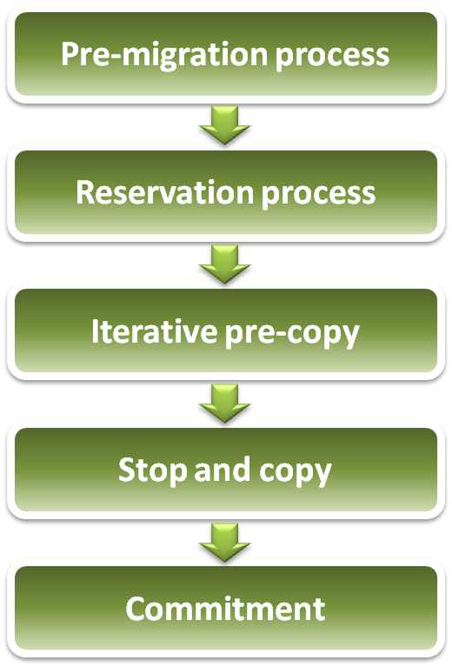
Live Migration Technique
Challenges of live migration :
VMs have lots of state in memory
Some VMs have soft real-time requirements :
For examples, web servers, databases and game servers, ...etc.
Need to minimize down-time
Relocation strategy :
Pre-migration process
Reservation process
Iterative pre-copy
Stop and copy
Commitment

Slide 22

Live Migration Technique
Pre-migration process
Reservation process
VM active on host A
Destination host selected (Block devices mirrored)
Initialize container on target host
Copy dirty pages in successive rounds
Suspend VM on host A
Redirect network traffic
Synch remaining state
Activate on host B
VM state on host A released
Iterative pre-copy
Stop and copy
Commitment

Slide 23
Live Migration Technique
Live migration process :
Pre-copy migration : Round 1
Host A
Host B

Slide 24
Live Migration Technique
Live migration process :
Pre-copy migration : Round 2
Host A
Host B

Slide 25
Live Migration Technique
Live migration process :
Stop and copy : Final Round
Host A
Host B

Slide 26

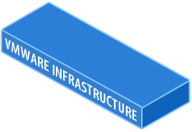
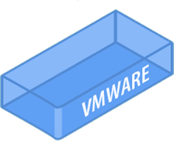

Scalability in Virtualization
Scalability implement by VMware:
VMware VMotion, makes it possible to move Virtual Machines, without interrupting the applications running inside.
Dynamically scale up virtual machine system among physical servers.

Slide 27
Availability in Virtualization
Fault tolerance system :
VMware makes all Servers and Applications protected against component and complete system failure.
When system failure occurs, virtual machines will be automatic restarted on other physical servers.
X

Slide 28
Availability in Virtualization
Disaster recovery :
VMware Site Recovery Manager enables an easy transition from a production site to a Disaster Recovery site.
Easy Execution for real Disaster
Easy Testing for good night sleep
X

Slide 29


Availability in Virtualization
Fail over technique
Backup VM
Backup VM
X
Application protection against hardware failures, with NO down time that is Application and Operating System Independent.

Slide 30
Manageability in Virtualization
Provide physical to virtual translation :
Consolidation Management with the VMware Infrastructure software will automate the migration from physical to virtual machines.

Slide 31
Performance in Virtualization
Dynamic load balancing :
VMware Distributed Resource Scheduler automatically balances the Workloads according to set limits and guarantees.
Removing the need to predict resource assignment.

Slide 32
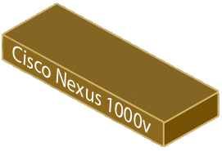
Performance in Virtualization
Optimize network access :
VMware and Cisco are collaborating to enhance workload mobility and simpler management with virtualization-aware networks.
Nexus 1000V

Slide 33
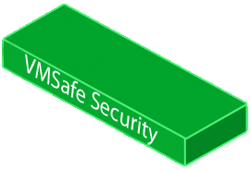






Security in Virtualization
Enhance virtual machine security protection :
The Application vService VMSafe allows security vendors to add superior security solutions inside the VMware Infrastructure.

Slide 34
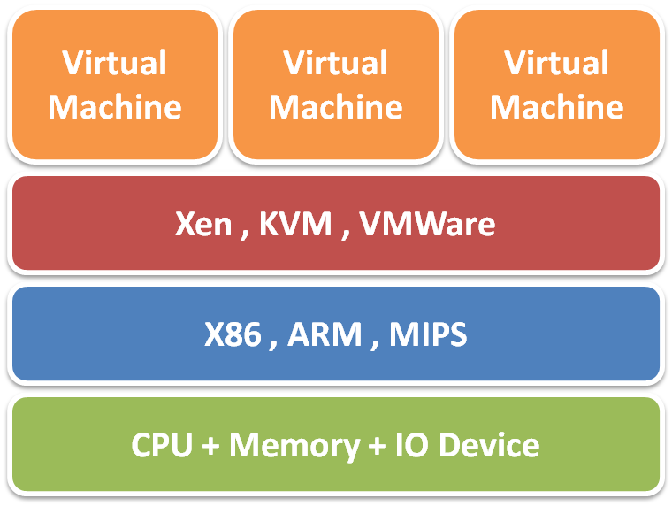
Summary
Server virtualization technique :
CPU virtualization
Ring compression, Intel VT-x, …etc
Memory virtualization
Shadow page table, Intel EPT, …etc
IO virtualization
Device model, Intel VT-d, PCIe SR-IOV, …etc
Ecosystem :
VMware implements both type-1 & type-2 virtualization
Xen implements both para and full virtualization
KVM implements in Linux mainstream kernel
Cloud properties :
Enabled by live migration technique
Scalability, Availability, Manageability and Performance

Slide 35
References
Books :
James E. Smith & Ravi Nair, Virtual Machines, Elsevier Inc., 2005
Web resources :
Xen project http://www.xen.org
KVM project http://www.linux-kvm.org/page/Main_Page
IBM VirtIO survey https://www.ibm.com/developerworks/linux/library/l-virtio
PCI-SIG IO virtualization specification http://www.pcisig.com/specifications/iov
Other resources :
Lecture slides of “Virtual Machine” course (5200) in NCTU
Vmware Overview Openline presentation slides http://www.openline.nl
Xen presentation http://www.cl.cam.ac.uk/research/srg/netos/papers/2006-xen-fosdem.ppt

